Slide 1


Here's your outline to get started
Key facts about your topic
Environmental issues are harmful effects of human activity on the biophysical environment. Environmental protection is a practice of protecting the natural environment on individual, organizational or governmental levels, for the benefit of both the environment and humans. Environmentalism, a social and environmental movement, addresses environmental issues through advocacy, education and activism.
See more: Open the Notes below for more information.
Notes:
QuickStarter has created an outline to help you get started on your presentation. Some slides include information here in the notes to provide additional topics for you to research.

Slide 2
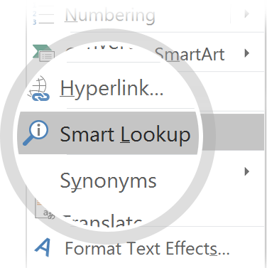
Related topics to research
Human Impact on the Environment
Environmental Degradation
Water pollution
Environmental issues in India
Environmental issues in Southern Africa
Environmental issues in Australia
Environmental Movement
Environmental Engineering
Exploitation of Natural Resources
Environmental issues in China
Use Smart Lookup to learn more
1
Highlight one of the related topics
Right-click on the topic
Choose "Smart Lookup"
2
3

Slide 3

What the frack
Testing Done Around Fracking Sites
By
Angel Martinez
Benjamin Johnson
Cyrus Yousefian
Kevin Nguyen

Slide 4

Fracking
Mining for natural gas by drilling and fracturing through shale to release trapped gas
Documented in 10 California counties — Los Angeles, Ventura, Santa Barbara, Sacramento, Colusa, Glenn, Kern, Monterey, Sutter, and Kings. ... In Kern County, California's major oil-producing county, 50 to 60 percent of new oil wells are fracked

Slide 5
Issues
Methane pollution from cracks in gas wells and
Hydraulic fluid consisting of carcinogens chemicals leach into underground water wells and aquifers
Earth shifting
Not enough environmental requirements imposed

Slide 6
Solution
To create a device that will collect the data of methane outflow, fluid leakage into underground aquifers, and any fissures or earth shifts
Data displayed on graphs in real-time for monitoring and alert for contaminations breaches

Slide 7
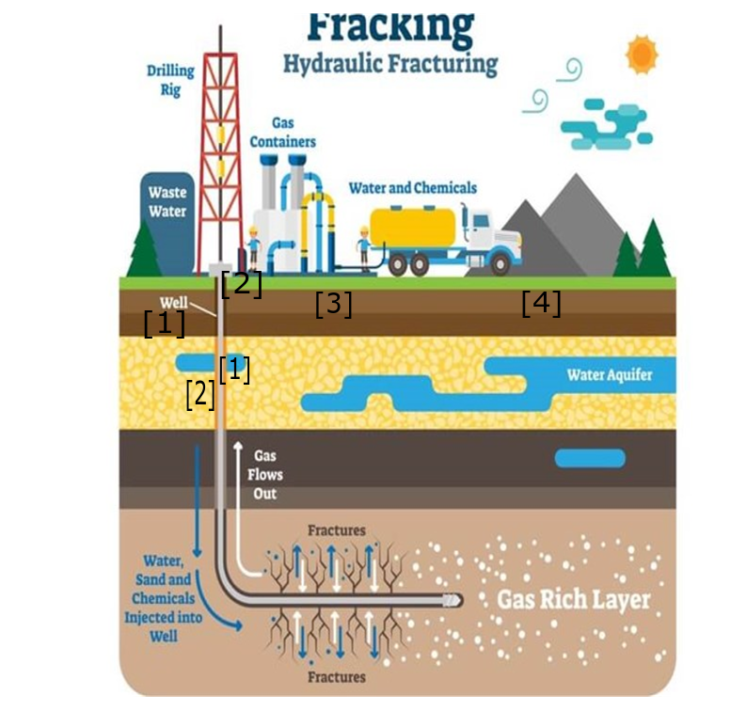
Sensor Layout
[1] Water / voltage sensors
Below waste water
Embedded in concrete sheath
[2] methane sensor
Near outlet
Embedded in concrete sheath
[3] Seismic (vibration) sensor
[4] Temperature sensor
soil

Slide 8
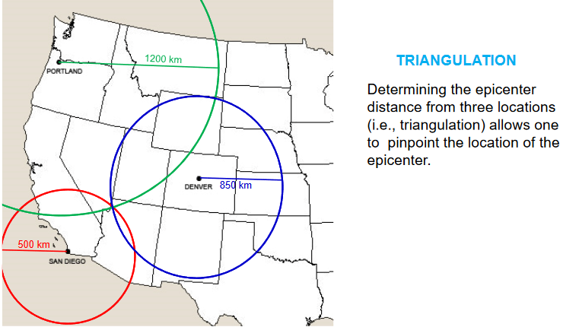
Tests
Check Fracking Sites for Air pollution and green house gas levels using MQ5
Check for water breach pollution using water sensor around site
using temperature sensor to test soil surrounding the area
Using vibration sensor to check for seismic activity around sites, and use triangulation to pin-point epicenter of Earthquakes

Slide 9
Why is this useful?
To quantify fracking site data on how it impacts the surrounding environment and local water wells
Spread awareness with collected data to politicians, congress, and citizens to push better policies on fracking in California
Impose stricter regulations in stead of what fracking companies disclose on reports

Slide 10
Other implementations:
Use the methane sensor to detect natural gas in waterways (Flint. Mn)
Test along the coast of California for possible tsunamis from coastal fracking

